Slide 1

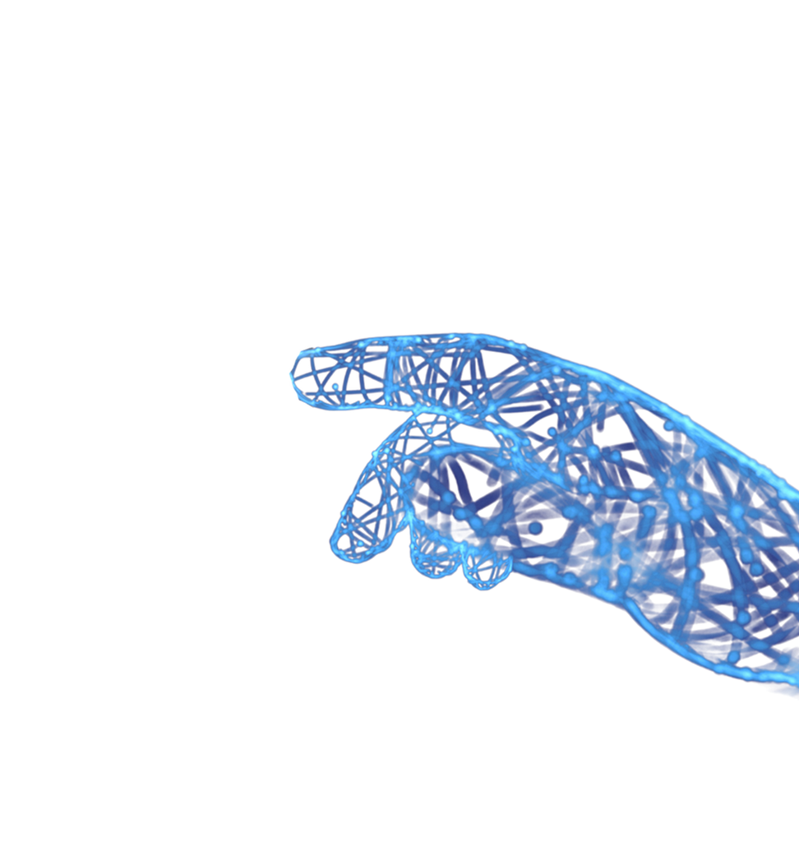

www.bilvantis.io
linkedin.com/bilvantistechnologies
TRANSFORMING BUSINESS OUTCOMES WITH INNOVATIVE SOLUTIONS

Slide 2

ARTIFICIAL INTELLIGENCE
www.bilvantis.io

Slide 3

www.bilvantis.io
THANK YOU!
Narasimha Rao Vadde
Founder & CEO
E: narasimha@bilvantis.io
M: +1 943 888 1238
+91 98666 01238
India
The Square, 110, Block B, 3rd Floor, Financial District, Hyderabad, Telangana 500032, IN.
USA
5601 Executive Dr,
Suite 500, Office-513,
Irving, Texas 75038, US
LEADING-EDGE IT SOLUTIONS PROVIDER THAT
DELIVERS ADVANCED RAPID TRANSFORMATIONS
linkedin.com/bilvantistechnologies

